Slide 1












Slide 2


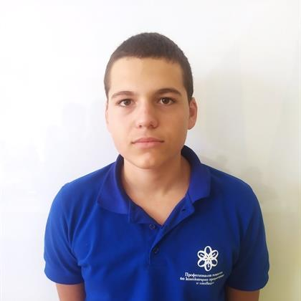
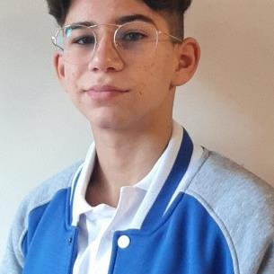
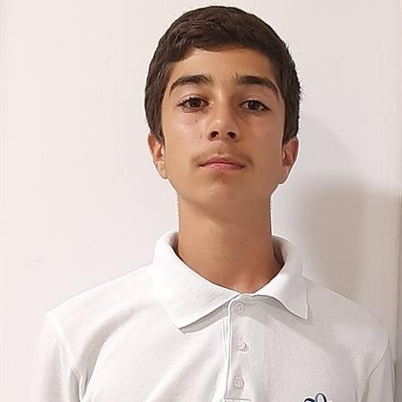
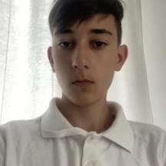
Our team
Todor Yordanov Atanasov
Ivan Doychinov Dochev
Scrum trainer
Back-end developer
Apostol Yanev Kupenov
Teodor Stoqnov Madjarov
Back-end developer
QA engineer

Slide 3



The plan!

Slide 4










Used Technologies

Slide 5
Thanks for the attention!
Let’s jump to the code!

